Slide 1
Lecture 17 CUDA and MPI
Guideline for Term Project Report Included at Page 2.
Kyu Ho Park
June 8, 2017
Ref:
1.David Kirk and Wen-mei Hwu, Programming Massively Parallel Processors, MK and NVIDIA.
2.Michael J. Quinn, Parallel Programming in C with MPI and OpenMP.
3.John Cheng, Max Grossman,Ty McKercher,Professional CUDA C Programming, Wrox.
4.Gerassimos Barlas,Multicore and GPU Programming, MK.

Slide 2
Guideline of Term Project Report
1. Guideline of Term Project Presentation and Demonstration
Time and Day : 10:00~12:00 AM,June 22 at Room 2220
5~10 minutes for each team
Max. 10 pages in ppt file
Contents: Title, Motivation, Problem Description,
How to Solve, Deliverable, Task Allocation
for each member and Demonstration.
2. Submission:[To TA Joo Kyung Ro (eu8198@kaist.ac.kr)]
Report:Max. 10 pages in A4, font 10. excluding screen captured images, graphs and program codes.
Your_source_code.zip should be attached(for the lectures next year).
Your presentation ppt file (for the lectures next year).

Slide 3
MPI
MPI(Message Passing Interface): It assumes a distributed memory model where processes exchange information by sending messages to each other.
MPI programs are based on the SPMD(single program , multiple data) parallel execution model. That is, all MPI processes execute the same program.
MPI is a set of API functions for communication between processes in a computing cluster.

Slide 4
Distributed Memory Architecture
Message passing
CPU
CPU
…..
M
M
a node

Slide 5
Point-To-Point Communication
Process i
Process j
…
if(id==i){
MPI_Send(&a,1,MPI_FLOAT
Compute
Compute
Wait
Send to j
Compute
Receive from i
Compute

Slide 6
Shared Memory Architecture
………
CPU
CPU
M

Slide 7
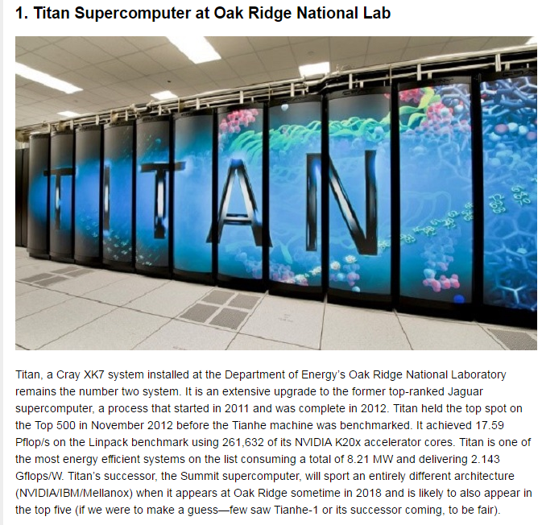
Titan Supercomputer

Slide 8
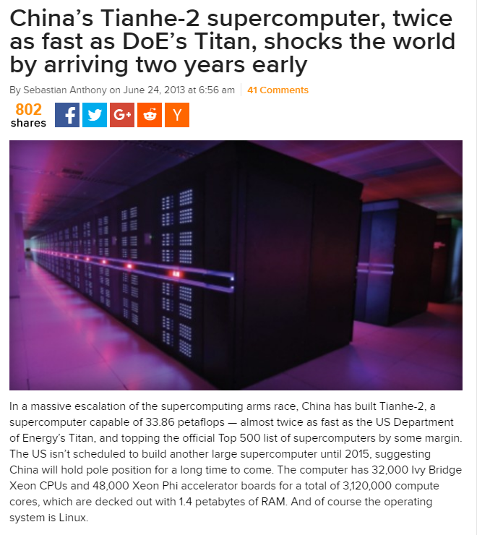

Slide 9
Basic MPI API functions
int MPI_init(int *argc, char ***argv)
Initialize MPI. The argc,argv are required only in the C language binding, where they are the main program’s arguments.
int MPI_Comm_RANK(MPI_Comm comm,int *rank)
Determine the identifier of the current process.
IN: comm(communicator), OUT: rank(process id in the group of comm).
int MPI_Comm_SIZE(MPI_Comm comm,int *size)
Determine the number of processes in a computation.
int MPI_Comm_abort(MPI_Comm comm)
Terminate MPI communication connection with an error flag.
int MPI-Finalize()
Ending an MPI application and close all resources.

Slide 10
MPI Communicator
A fundamental concept in MPI is the communicator, a distributed object that supports both collective and point-to-point communication.
By default MPI creates the MPI_COMM_WORLD communicator immediately after the call to MPI_Init().
When MPI has been initialized, every active process becomes a member of a communicator called MPI_COMM_WORLD.
MPI_COMM_WORLD includes all the MPI processes in the application.

Slide 11
MPI Rank
Every process in a communicator has its own identifier assigned by the system when the process is initialized. The rank is called a task id. A master process ,the assigned rank is 0, controls all other slave process of rank greater than 0.

Slide 12
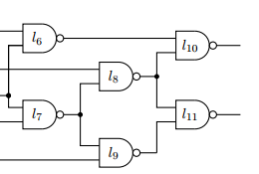

Satisfiability Test of a Logic Circuit
i₀
i₁
.
.
.
.
.
.
.
.
.
i₃₂
…………………………..
out
………………
circuit_check(id, i);
,where i=0~(2³² -1).
2³² = 4,294,967,296

Slide 13
example[2]
#include “mpi.h”
#include <stdio.h>
int main(int argc,char *argv[]){
int i;
int id; //Process rank
int p; //Number of processes
void circuit_check(int, int);
MPI_init(&argc,&argv);
MPI_Comm_rank(MPI_COMM_WORLD, &id);
MPI_Comm_size(MPI_COMM_WORLD,&p);
for(i=id;i<4294967296;i+=p)
circuit_check(id,i);
printf(“Process %d is done\n”,id);
fflush(stdout);
MPI_Finalize();
return 0;
}

Slide 14
MPI_Finalize()
after a process has completed all of its MPI calls, it calls function MPI_Finalize to release resources allocated to MPI.

Slide 15
Data Types Required By the MPI Standard
C Data Types
MPI_CHAR,MPI_SHORT,MPI_INT,MPI_LONG
MPI_UNSIGNED_CHAR,MPI_UNSIGNED_SHORT,
MPI_UNSIGNED, MPI_UNSIGNRD_LONG,
MPI_FLOAT, MPI_DOUBLE, MPI_LONG_DOUBLE
MPI_BYTE
MPI_PACKED

Slide 16
Point-To-Point Communication
Process i
Process j
…
if(id==i){
MPI_Send(&a,1,MPI_FLOAT
Compute
Compute
Wait
Send to j
Compute
Receive from i
Compute

Slide 17
Point-to-Point Communication
float a,b,c;
int id,
MPI_Status status;
…
if(id==i){
MPI_Send(&a,1,MPI_FLOAT,id,0,MPI_COMM_WORLD);
} else if (id==j){
MPI_Recv(&a,1,MPI_FLOAT,id,0,MPI_COMM_WORLD,&status);
}

Slide 18
Basic MPI API functions MPI_Send()
int MPI_Send()(void *buf, int count,MPI_Datatype datatype,int dest, int tag, MPI_Comm comm)
,where
buf: starting address of send buffer,
count: Number of elements in sending buffer,
datatype: Datatype of each send buffer element,
dest: Rank of destination,
tag: Message tag,
comm: communicator.
MPI_Send implements a blocking send operation. When the function returns, the message buffer may be immediately reused.

Slide 19
Basic MPI API function MPI_Recv()
int MPI_Recv(void *buf, int count,MPI_Datatype datatype,
int source, int tag, MPI_Comm comm, MPI_Status *status)
,where
buf: starting address of receive buffer,
count: maximum number of elements in receive buffer,
datatype: datatype of each receive buffer element,
source: rank of source,
tag: message tag,
comm: communicator,
status: status.
MPI_Recv implements a blocking receive. Assuming the receive is successful, when control returns from MPI_Recv, buffer points to the received message.

Slide 20
Deadlock Example1 [2]
float a,b,c;
int id;
MPI_Status status;
…
if(id==0){
MPI_Recv(&b,1,MPI_FLOAT,1,0,MPI_COMM_WORLD,&status);
MPI_Send(&a,1,MPI_FLOAT,1,0,MPI_COMM_WORLD);
c=(a+b)/2.0;
} else if(id==1){
MPI_Recv(&a,1,MPI_FLOAT,0,0,MPI_COMM_WORLD,&status);
MPI_Send(&b,1,MPI_FLOAT,0,0,MPI_COMM_WORLD);
c=(a+b)/2.0;
}

Slide 21
Deadlock Example2 [2]
float a,b,c;
int id;
MPI_Status status;
…
if(id==0){
MPI_Send(&a,1,MPI_FLOAT,1,1,MPI_COMM_WORLD);
MPI_Recv(&b,1,MPI_FLOAT,1,1,MPI_COMM_WORLD,&status);
c=(a+b)/2.0;
} else if(id==1){
MPI_Send(&b,1,MPI_FLOAT,0,0,MPI_COMM_WORLD);
MPI_Recv(&a,1,MPI_FLOAT,0,0,MPI_COMM_WORLD,&status);
c=(a+b)/2.0;
}

Slide 22
Other Synchronous Communication Modes
Buffered
MPI_Bsend(void *buf,int count,MPI_Datatype datatype,int dest,int tag,MPI_Comm comm); /*The buffer is user provided.*/
Synchronous
MPI_Ssend(void *buf,int count,MPI_Datatype datatype,int dest,int tag,MPI_Comm comm); /*The sending operation will return only after the destination process has initiated and started the retrieval of the message.*/
Ready
MPI_Rsend(void *buf,int count,MPI_Datatype datatype,int dest,int tag,MPI_Comm comm); /*The send operstion will succedd only if a matching receive operation has been initiated already*/

Slide 23
Non Blocking Communication
int MPI_Isend(void *buf,int count,MPI_Datatype datatype,int source,int tag,MPI_Comm comm, MPI_Request *req)
int MPI_Irecv(void *buf,int count,MPI_Datatype datatype,int source,int tag,MPI_Comm comm, MPI_Request *req)

Slide 24
MPI_Reduce()
int MPI_Reduce(
void *send_buffer, //IN-Send buffer
void *recv_buffer, //OUT-Receive buffer
int cnt, //IN-Number of elements to reduce
MPI_Datatype dtype, //IN-Element type
MPI_Op op, //IN-Reduction operator
int root, //IN-Rank of root process
MPI_Comm comm //IN-Communicator
)
MPI_Reduce is a collective communication function that performs cnt reductions. When the function returns, the process with rank root has the result of the reductions.

Slide 25
Reduction Operator in MPI
Symbolic Name | Description
MPI_SUM | Summation
MPI_MIN | Minimum
MPI_MAX | Maximum
MPI_PROD | Product
MPI_LAND | Logical AND
MPI_BAND | Bitwise AND
MPI_LOR | Logical OR
MPI_BOR | Bitwise OR
MPI_LXOR | Logical XOR
MPI_BXOR | Bitwise XOR
MPI_MAXLOC | Maximum and its location
MPI_MINLOC | Minimum and its location

Slide 26
MPI_Sendrecv()
int MPI_Sendrecv(
void *send_buffer, //IN-Send buffer
int send_ct, //IN-Elements to send
MPI_Datatype send_dtype //IN-Outgoing message element type
int dest, //IN-Destination process for message
void *recv_buffer, //OUT-Receive buffer
int recv_cnt, //IN-Elements to receive
MPI_Datatype recv_dtype, //IN-Ingoing message element type
int src, //IN-Source process of incoming message
int recv_tag, //IN-Incoming message ID
MPI_Comm comm, //IN-Communicator
MPI_Status *status //OUT-Status of received message
)
Replacing two individual send-receive function calls with a single call to MPI_Sendrecv guarantees a deadlock-free situation.

Slide 27
MPI_Barrier()
MPI_Barrier (
MPI_Comm //IN-Communicator
)
MPI_Barrier is a collective communication function that performs a barrier synchronization among all processes in the specified communicator.

Slide 28
Collective Communications
The Collective communication refers to operations that involve more than two nodes.
-One-to-all: MPI_Bcast, MPI_Scatter,MPI_Scatterv
-All-to-one: MPI_Gather,MPI_Gatherv, MPI_Reduce
-Allto-all: MPI_Alltoall, MPI_Alltoallv,MPI_Allreduce,
MPI_Allgather,MPI_Barrier

Slide 29
MPI_Bcast( )
int MPI_Bcast(
void *buffer, //IN/OUT-Message address
int cnt, //IN-Elements in message
MPI_Datatype dtype //IN-Element type
int root, //IN-Rank of root process
MPI_Comm comm //IN-Communicator
)
MPI_Bcast is a collective communication operation allowing one process to broadcast a message to all other processes in a communicator. Parameter root is the rank of the process with the message to broadcast.

Slide 30
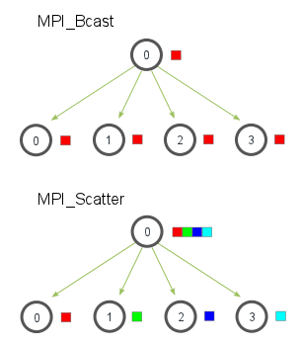
MPI_Bcast and _Scatter
MPI_Bcast takes a single data element at the root process (the red box) and copies it to all other processes. MPI_Scatter takes an array of elements and distributes the elements in the order of process rank.
http://stackoverflow.com/questions/27753153/differences-between-mpi-scatter-and-mpi-bcast

Slide 31
MPI_Abort()
unt MPI_Abort(
MPI_Comm comm, //IN-Communicator
int error_code //IN-Error code
)
MPI_Abort makes a best effort attempt to abort all processes in the specified communicator. It returns the error code to the calling environment.

Slide 32
SPMD MPI program[4]
#include <mpi.h>
#include <string.h>
#include <stdio.h>
#define MESSTAG 0
#define MAXLEN 100
int main(int argc,char **argv){
MPI_Init(&argc, &argv);
int rank, num, I;
MPI_Comm_rank(MPI_COMM_WORLD,&rank);
MPI_Comm_Size(MPI_COMM_WORLD,&num);
if(rank==0){
char mess[]=“Hello MPI!”;
int len=strlen(mess)+1;
for(i=1;i<num;i++)
MPI_Send(mess,len,MPI_CHAR, i ,MESSTAG,MPI_COMM_WORLD);
} else{
char mess[MAXLEN];
MPI_Status status;
MPI_Recv (mess,MAXLEN,MPI_CHAR,0,MESSTAG,MPI_COMM_WORLD,&status);
printf(Process %i received %s\n”,rank,mess);
}
MPI_Finalize();
return 0;
}

Slide 33
MPI example(simpleMPI.c)
#include <mpi.h>
#include <stdio.h>
int main(int argc, char **argv){
int rank, num,i;
MPI_Init(&argc,&argv);
MPI_Comm_rank(MPI_COMM_WORLD,&rank);
MPI_Comm_Size(MPI_COMM_WORLD,&num);
printf(“Process id: %i, Num of Processes: %i\n”,rank,num);
MPI_Finalize();
return 0;
}

Slide 34
compile simpleMPI.c
$mpicc simpleMPI.c -o simpleMPI
or
$gcc simpleMPI.c –o simpleMPI –I /usr/include/mpi –lmpi
To deploy the program over multiple machines, a hostfile has to be specified. The hostfile is a text file containing a list of the Ips of the machines that will host the executing processes.
hostfile
143.248.165.1
143.248.165.3
143.248.165.6
$mpirun –hostfile hosts –np 3 simpleMPI

Slide 35
Communicators and Group
Creating Groups
from a communicator:
int MPI_Comm_group(MPI_Comm comm, MPI_Group *group)
//It returns the process group associated with communicator comm.
from an existing group:
int MPI_Group_incl(MPI_Group group, int n, int *ranks, MPI_Group *newgroup)
//It produces a new group from an existing group.
int MPI_
Group_excl(MPI_Group group, int n, int *ranks, MPI_Group *newgroup)
//It produces a new group by removing processes listed at the rank.

Slide 36
MPI and CUDA
Two types of MPI implementation
-Traditional MPI
-CUDA-aware MPI
Traditional MPI:
-The contents of host memory can be transmitted by MPI functions.
-The contents of GPU memory must be copied back to the host using the CUDA API and then the host can communicate with the host of the other nodes using MPI functions.
CUDA-aware MPI:
-We can pass the contents of GPU memory directly to MPI functions without passing through the host memory.

Slide 37
CUDA-aware MPI
-MVAPICH2 2.0rc2
(http://mvapich.cse.ohio-state.edu/download/mvapich2)
:Open source MPI to exploit Infiniband. CUDA-aware.
-MVAPICH2-GDR 2.0b
(http://mvapich.cse.ohio-state/edu/download/mvapich2gdr)
:An Extention to support for GPUDirect RDMA over Infiniband.
-OpenMPI 1.7
(http://www.open-mpi.org/software/ompi/v1.7)
-CRAY MPI(MIPT 5.6.2)
-IBM Platform MPI(8.3)
:MVAPICH2 is a widely used open-source MPI library for Infiniband clusters and supports MPI communication directly from one GPU’s memory to another’s.

Slide 38
CPU Affinity
CPU Affinity( Soft and Hard):
There are two types of CPU affinity. The first, soft affinity, also called natural affinity, is the tendency of a scheduler to try to keep processes on the same CPU as long as possible. It is merely an attempt; if it is ever infeasible, the processes certainly will migrate to another processor.
Hard affinity, on the other hand, is what a CPU affinity system call provides. It is a requirement, and processes must adhere to a specified hard affinity. If a processor is bound to CPU zero, for example, then it can run only on CPU zero.

Slide 39
GPU-to GPU Data Transfer
Affinity in MPI-CUDA Programs:
CPU affinity:
Binding an MPI process to a CPU core.
GPU affinity:
Binding an MPI process to a particular GPU.

Slide 40
GPU-to-GPU communication with MPI[3]
if(rank==0){
for(int i=0;i<loop;i++){
cudaMemcpy(h_src,d_src,size,cudaMemcpyDeviceToHost);
MPI_Irecv(h_rcv,size,MPI_CHAR,other_proc,10,MPI_COMM_WORLD,
&recv_request);
MPI_Isend(h_src,size,MPI_CHAR,other_proc,100,MPI_COMM_WORLD,
&send_request);
MPI_Waitall(1,&recv_request,&reqstat);
MPI_Waitall(1,&send_request,&reqstat);
cudaMemcpy(d_rcv,h_rcv,size,cudaMemcpyHostToDevice);
}
} else {
for(int i=0;i<loop;i++){
cudaMemcpy(h_src,d_src,size,cudaMemcpyDeviceToHost);
MPI_Irecv(h_rcv,size,MPI_CHAR,other_proc,100,MPI_COMM_WORLD,
&recv_request);
MPI_Isend(h_src,size,MPI_CHAR,other_proc,10,MPI_COMM_WORLD,
&send_request);
MPI_Waitall(1,&recv_request,&reqstat);
MPI_Waitall(1,&send_request,&reqstat);
cudaMemcpy(d_rcv,h_rcv,size,cudaMemcpyHostToDevice);
}

Slide 41
GPU-to-GPU communication with CUDA-aware MPI[3]
if(rank==0){
for(int i=0;i<loop;i++){
//cudaMemcpy(h_src,d_src,size,cudaMemcpyDeviceToHost);
MPI_Irecv(h_rcv,size,MPI_CHAR,other_proc,10,MPI_COMM_WORLD,
&recv_request);
MPI_Isend(h_src,size,MPI_CHAR,other_proc,100,MPI_COMM_WORLD,
&send_request);
MPI_Waitall(1,&recv_request,&reqstat);
MPI_Waitall(1,&send_request,&reqstat);
//cudaMemcpy(d_rcv,h_rcv,size,cudaMemcpyHostToDevice);
}
} else {
for(int i=0;i<loop;i++){
//cudaMemcpy(h_src,d_src,size,cudaMemcpyDeviceToHost);
MPI_Irecv(h_rcv,size,MPI_CHAR,other_proc,100,MPI_COMM_WORLD,
&recv_request);
MPI_Isend(h_src,size,MPI_CHAR,other_proc,10,MPI_COMM_WORLD,
&send_request);
MPI_Waitall(1,&recv_request,&reqstat);
MPI_Waitall(1,&send_request,&reqstat);
//cudaMemcpy(d_rcv,h_rcv,size,cudaMemcpyHostToDevice);
}

Slide 42
Multi-GPU System
GPU0
GPU1
GPU2
GPU3
PCIe
PCIe
Node0
InfiniBand IN
Node1

Slide 43
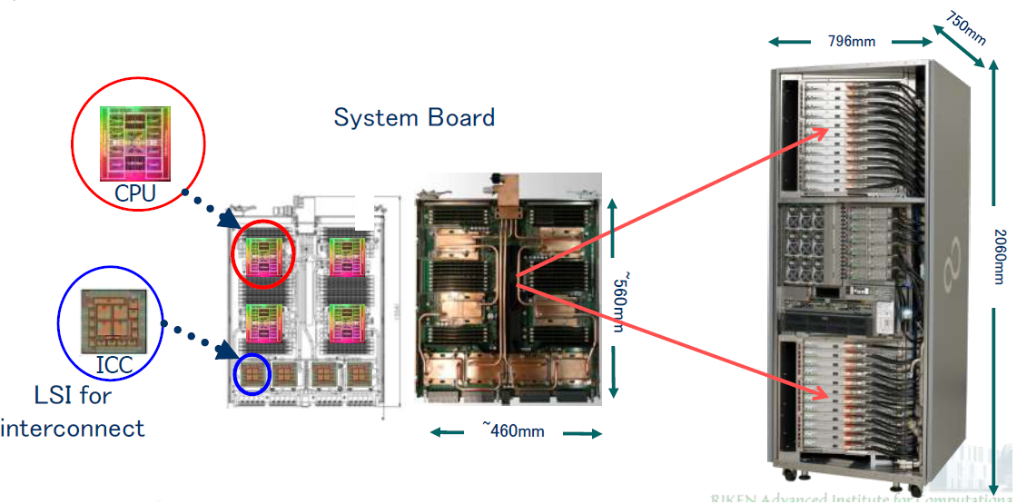
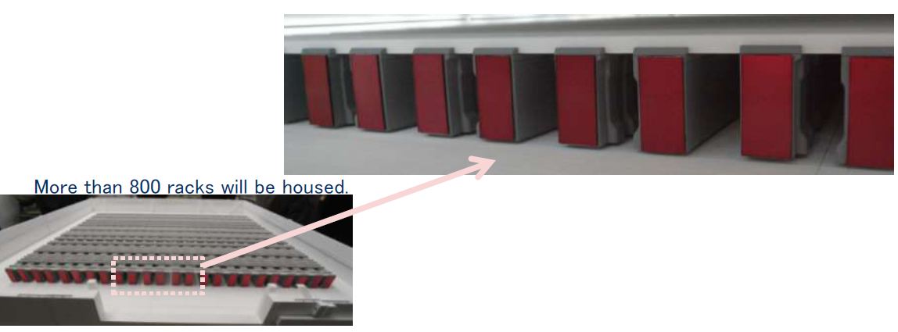
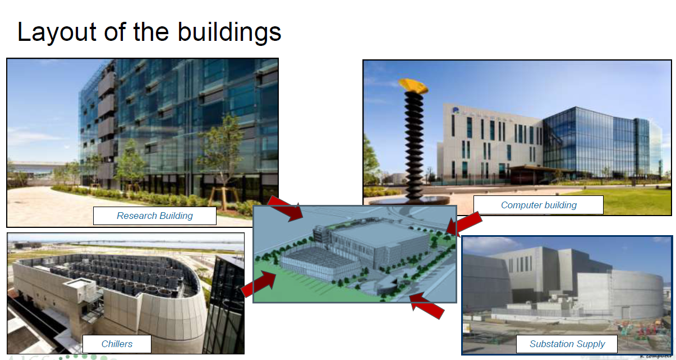
K Computer[RIKEN]
A rack consists of 24 system boards, 6 IO boards, and so on…

Slide 44
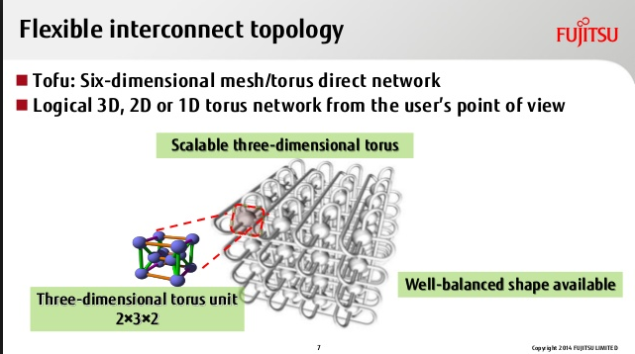
Intercpnnection of K-Computer

Slide 45
Executing on Multiple GPUs
A single host thread can manage multiple devices.
To get the number of CUDA-enabled devices,
cudaError_t cudaGetDeviceCount(int *count);
sample Program:
int ngpus;
cudaGetDeviceCount(&ngpus);
for(int i=0;i<ngpus;i++){
cudaDeviceProp devProp;
cudaGetDeviceProperties(&devProp,i);
printf(“Device %d has compute capability %d.%d.\n”,i, devProp.major,devProp.minor);
}

Slide 46
Set a device
cudaError_t cudaSetDevice(int id)
for(int i=0;i<ngpus; i++){
//set the current deivce
cudaSetDevice(i);
//execute kernel on current device
kernel<<<grid,block>>>(….);
//asynchronously transfer data between the host and //current device.
cudaMemcpyAsync(….);
}

Slide 47
Unified Virtual Addressing
To use UVA, applications must be compiled on a 64-bit architecture with devices of compute capability 2.0 or higher, and CUDA 4.0 or later installed.
0x0000
0xFFFF
CPU Memory
GPU1 Memory
GPU2 Memory
CPU
GPU1
GPU2
PCIe

Slide 48
To Check UVA of a device
int deviceID=0;
cudaDeviceProp prop;
cudaGetDeviceProperties(&prop,deviceId);
printf(“GPU%d: %s unifies addressing \n”,deviceId,
prop.unifiedAddressing ? “supported” : “does not support”);

Slide 49
sample codes
device 0 : current device, the kernel read global memory from device 1 using the pointer d_src[1], writing the result to the current device through the global memory pointer d_rcv[0]:
cudaSetDevice(0);
kernelFunction<<<grid, block>>>(d_rcv[0],d_src[1);

